Slide 1
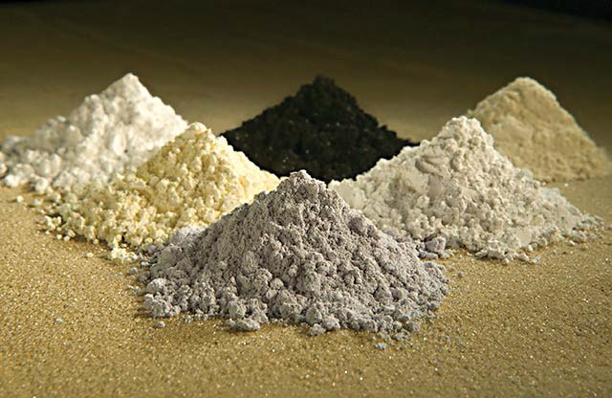
Kudos to China, Now Let's All Follow Suite:
(Long et. al., 2010)
An Examination of the Effect of China’s Restrictions on Exploration and Exportation of REE’s
By: Theresa Efinger
October 25th, 2012
IDS 3143: Issues in S&T
FGCU

Slide 2
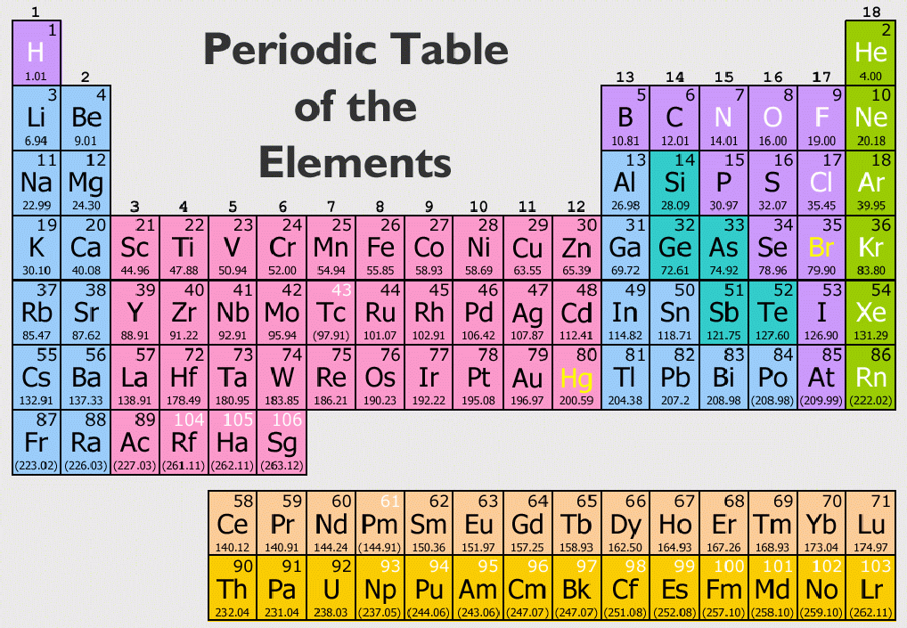
S&T: Rare Earth Elements (REEs)
REEs are often found in the same ore material and are difficult to extract from one another due to their very similar chemical properties (Long, et. al., 2010);
they are also known to occur within the same ore as “other elements, such as copper, gold, uranium, phosphates, and iron” (Humphries, 2012, p. 8).
REEs:
are toxic to the skin and body if almost any form is inhaled or ingested,
are easily decomposable in the air and/or water,
ignite easily or spontaneously, or can even be explosive ,
have some degree of radiation and have the ability to cause radiation poisoning
(Krebs, 1998)

Slide 3
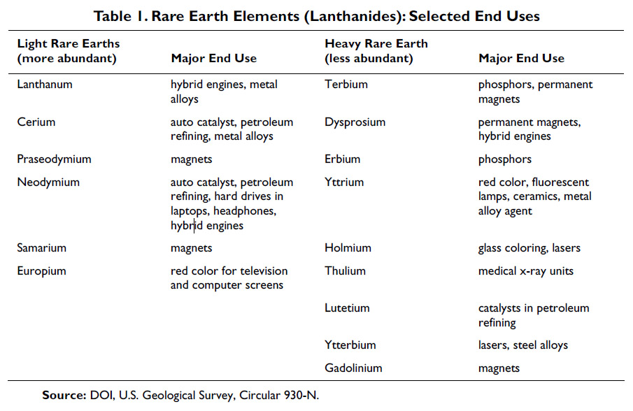
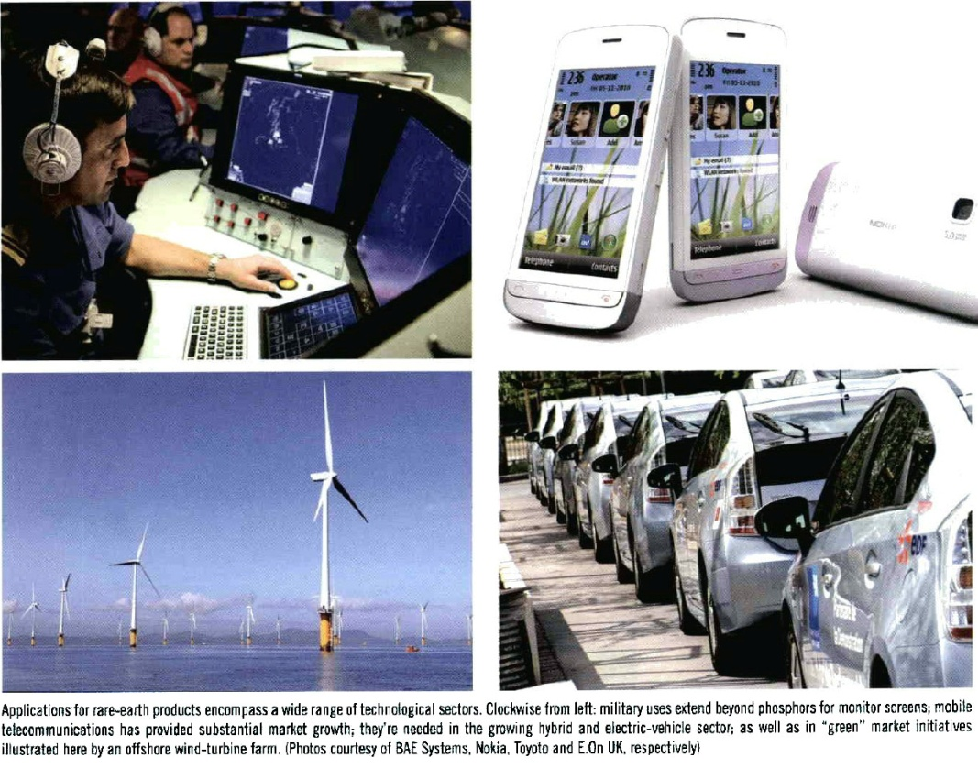
S&T: Rare Earth Elements (REEs) (cont’d)

Slide 4
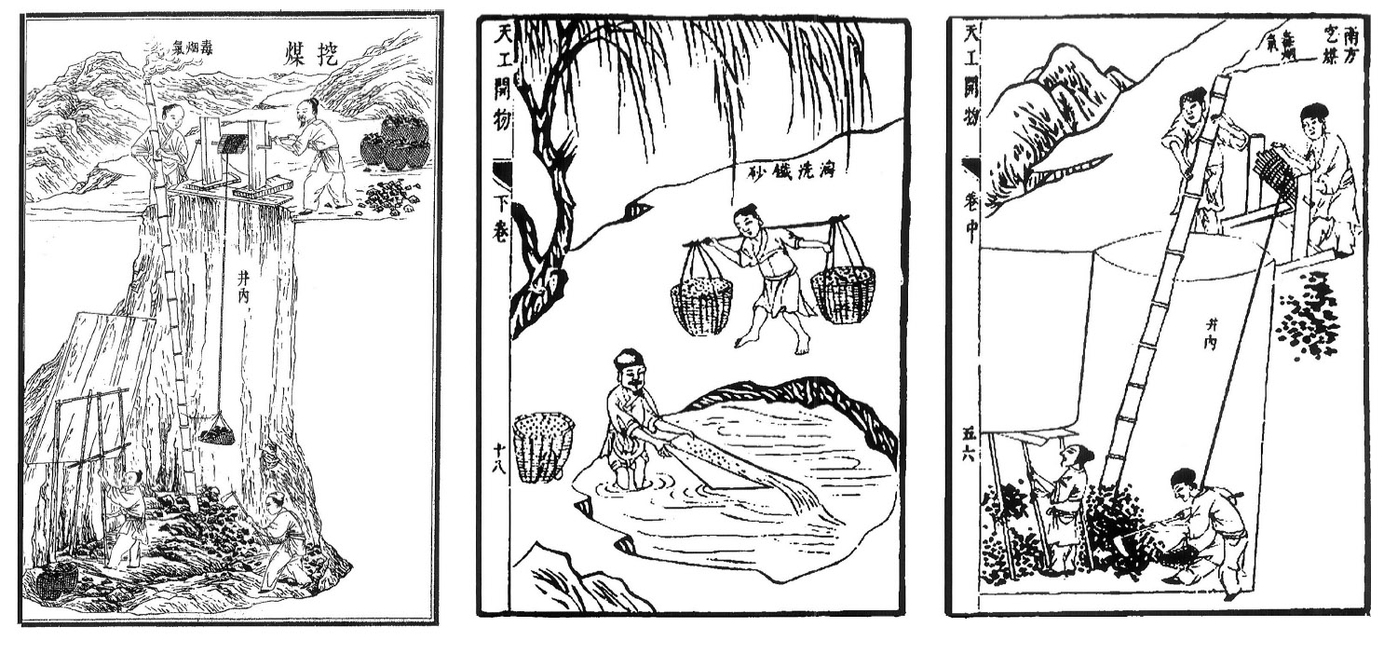
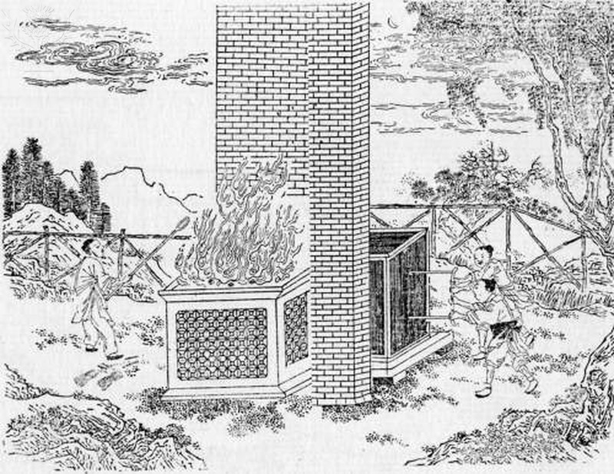
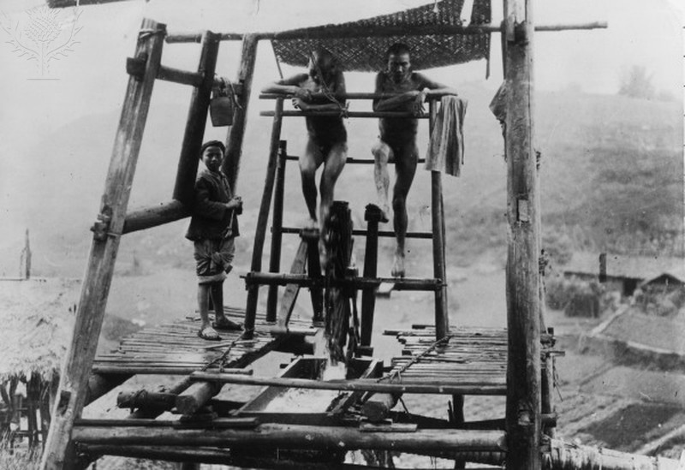
Technology of Mining
Illustrations from Song Yingxing’s Tiangong Kaiwu (1637), the earliest thorough description of ore processing methods in China
In the 1970s, in China, a 3000 year old mine was found with smelting facilities, more than 400,000 tons of ancient slag (Ottens, 2005).
From 1000 B.C.E to the middle ages, no significant developments in mining had taken place (Ottens, 2005).

Slide 5
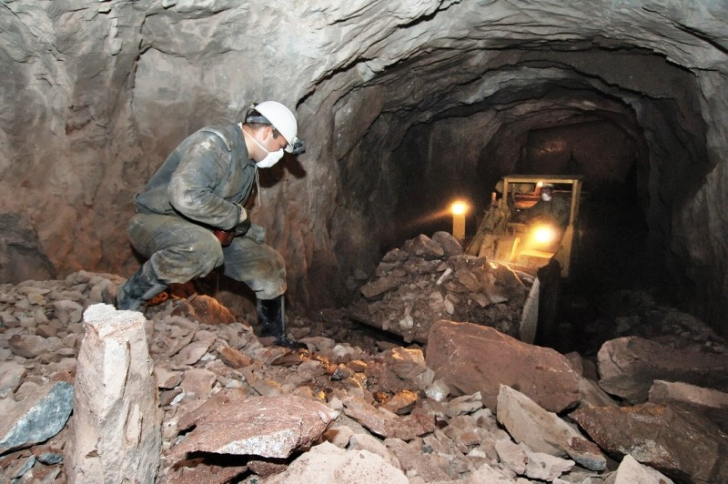
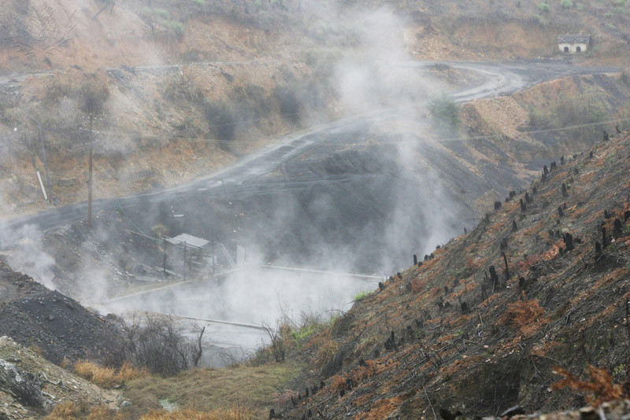
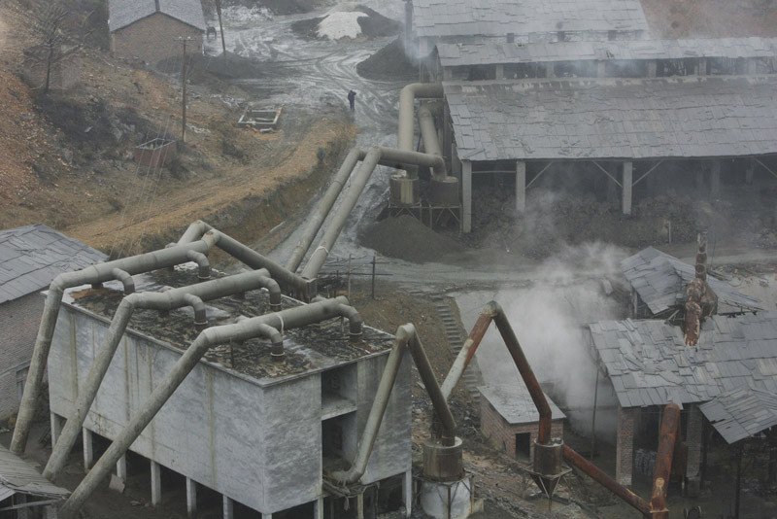
Tech. of Mining (cont’d)

Slide 6
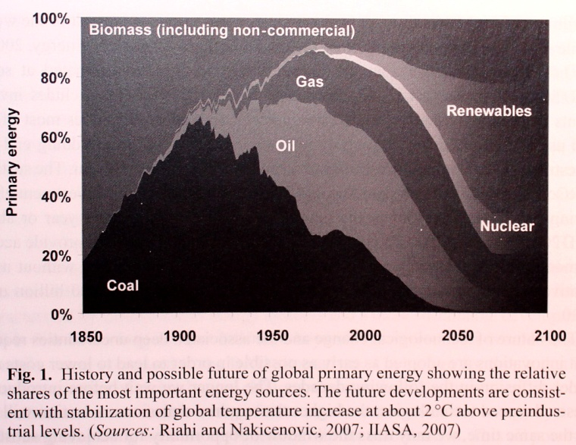
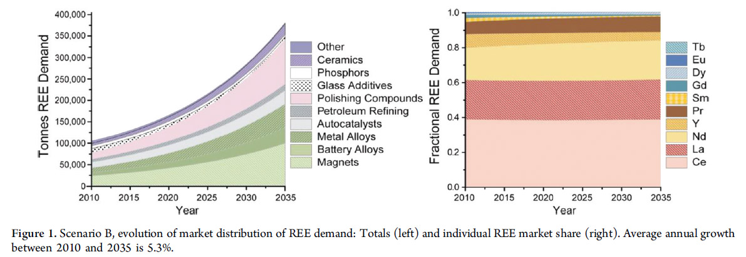
Why are REEs an issue?
Critical and Strategic Minerals
“Adequate supplies of needed minerals, particularly metals [that] are deemed to be essential for the well-being of a sovereign nation”, are stockpiled “as insurance against the interruption of supplies and unreasonable price increases” (Manahan, 1997, p. 400).
REEs are considered, by many, to be both ‘critical’ and ‘strategic’ minerals, as the pressure to move away from oil and coal, toward “clean” energy, causes their demand to increase.

Slide 7
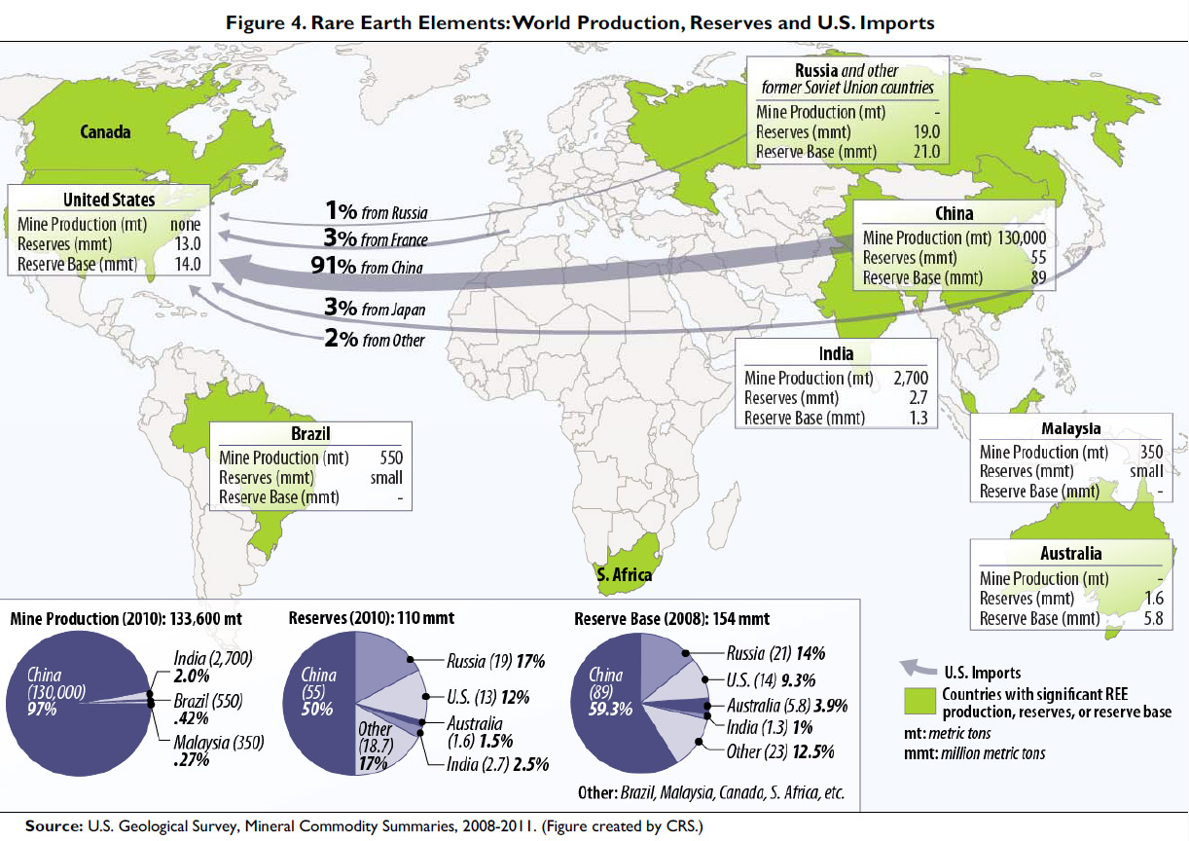
Why are REEs an Issue? (CONT’d)
From 1960-1980, the U.S., specifically the Molycorp Mountain Pass mine in California, was the world’s largest producer of REEs primarily due to its high-grade ore, low cost of production, and a growing demand for REEs (Humphries, 2012).
Even though the U.S. made significant advancements in REE mining and technologies, China has also been dedicated to the research and development of REEs:
- “Rare Earth Materials Chemistry and Applications, which has focused on rare earth separation techniques and is affiliated with Peking University;
- “and [the] Rare Earth Resource Utilization, which is associated with the Changchun Institute of Applied Chemistry”;
- China is also home to the “largest rare earth research center in the world”, which was established in 1963 (Humphries, 2012, p. 17).
Now, the U.S., EU, and Japan have filed a complaint with the World Trade Organization (WTO), after “China announced [in 2010] that it will introduce stricter standards for rare earth mining and will control the mining, sorting, and smelting of the minerals more tightly” (Mining Engineering, 2012).
China is restricting the exploration and exportation of REEs, and many countries feel that these restrictions violate the rules of the WTO.

Slide 8
My Stance
China should be allowed to place restrictions on the exploration and exportation of REEs in order to preserve natural resources and avoid causing detrimental environmental impact.
To aid in the preservation of these resources the U.S., EU, Japan, and Canada should adapt tight restrictions on the negative environmental impact that mining and extraction cause and initiate recycling programs in order to preserve a necessary natural resource.

Slide 9
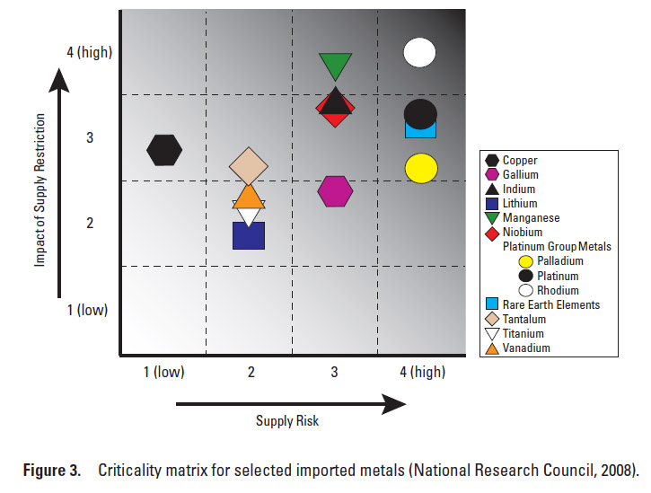
Political and Economic Influence
When particular natural resources, including metals like REEs, are of limited supply, they become “subject to political influences and financial manipulation” (Manahan, 1997, p. 399).
Example: “Cobalt Crisis” of 1978 (Alonso, 2012)
President Obama made an announcement in March 2012, saying that the U.S. had filed a complaint with the WTO concerning China; the U.S. government made this complaint because it feels that these restrictions were set into place “in order to help [the Chinese government] obtain unfair competitive advantages” (Humphries, 2012, p. 17).
“Investor analyst Jack Lifton reports that [China, South Korea, and Japan] are building strategic stockpiles of REEs” (Humphries, 2012, p. 18).
(Don’t the U.S. and other countries also have interest in stockpiling REEs?!)

Slide 10
Political and Economic (cont’d)
Jack Perkowski says the U.S. complain to the WTO about China’s restrictions was “politically motivated” (2012, October) and “by 2013 North America will already almost meet the [REE] production amount needed for national defense uses in the U.S.” (2012, June).
U.S. - Molycorp will achieve “full mine production [and] modernize its facilities” in the latter part of 2012
Canada- Two companies; one began drilling in 2010, another will be running in 2012 and has plans to incorporate domestic refinery of the material
Australia- New mine production to begin in 2012 (Humphries, 2012, p. 12).
“However, even if U.S. rare earth production ramps up, much of the processing/alloying and metal fabrication would occur in China” (Humphries, 2012, p. 14).
Unfortunately for the U.S. “there was a significant underinvestment in U.S. supply chain capacity (including processing, workforce development, R&D)” which meant that the U.S. was reliant on China as its sole source of REEs; meanwhile, China built a monopoly (Humphries, 2012, p.13).
According to Chinese officials, during one period of their plan, “sulfur dioxide emissions and chemical oxygen demand decreased by 14.29% and 12.45%, respectively” (WTO, 2012)

Slide 11
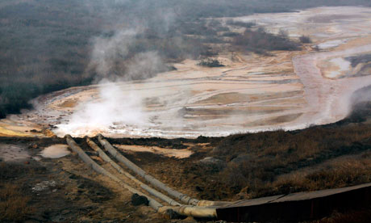
Societal and Cultural Influence
NIMBY
Currently, the method being used in the separating process for REEs generates ammonium nitrogen (NH₄-N) in the wastewaters that are released in the environment (Huang, et. al., 2009).
Other environmental concerns include “disturbance of land, air pollution from dust and smelter emissions, and water pollution from disrupted aquifers” (Manahan, 1997, p. 532).
“Many metals are present in ores as sulfides, and smelting can release large quantities of sulfur dioxide, as well as particles that contain heavy metals such as arsenic, cadmium, or lead” (Manahan, 1997, p. 388).
The tailings pond pictured (right), Processing plant in inner Mongolia. Contains toxic chemicals, and “radioactive elements such as thorium “which, if ingested, cause cancers of the pancreas and lungs, and leukemia” (Guardian Weekly, 2012)

Slide 12
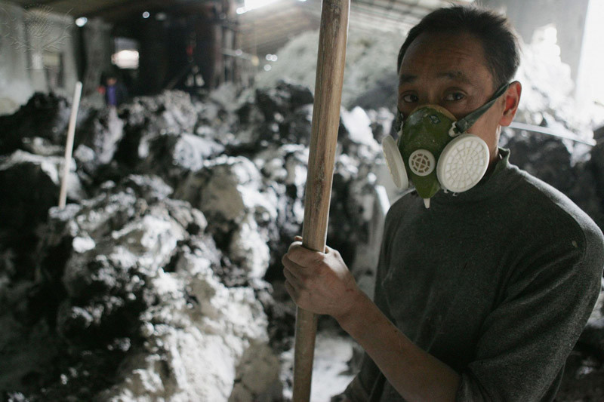
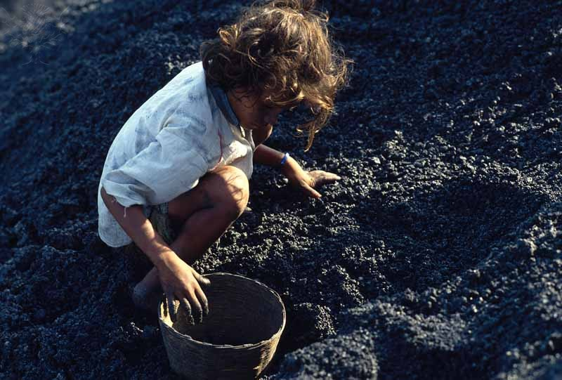
Societal and Cultural Influence (cont’d)
One thing that worries the society is that there are many health and safety issues associated with mining in China; the mining technology is very primitive and the mines are small and scattered throughout the country, lacking “expertise and capital” to guide them.
Up until the 21st century, human labor was often utilized because it was “cheap and abundant”.
“Between January and the end of October of 2003, accidents in all Chinese mines (most of them in the coal mines) took the lives of 13,283 people in all.” (Ottens, 2005, p. 9)

Slide 13
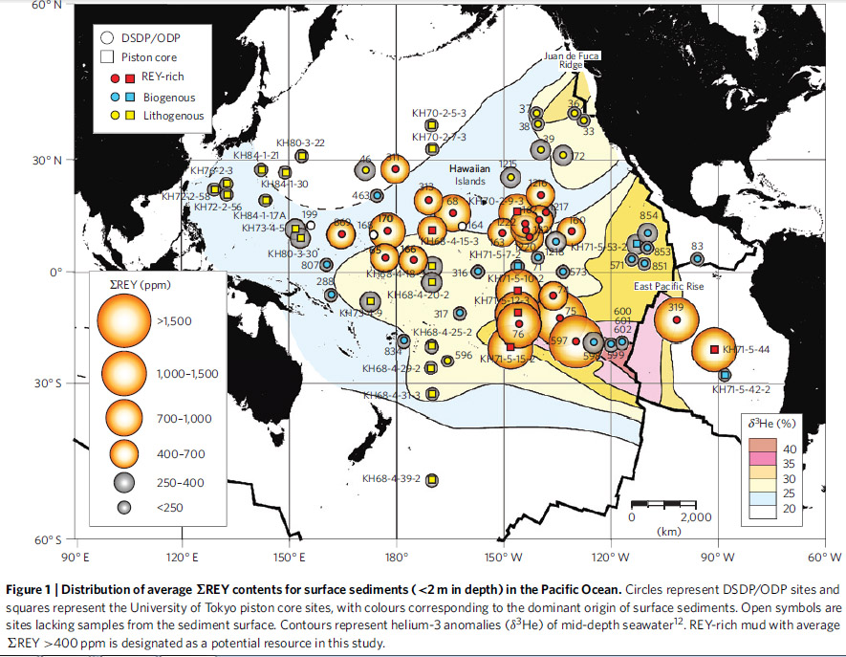
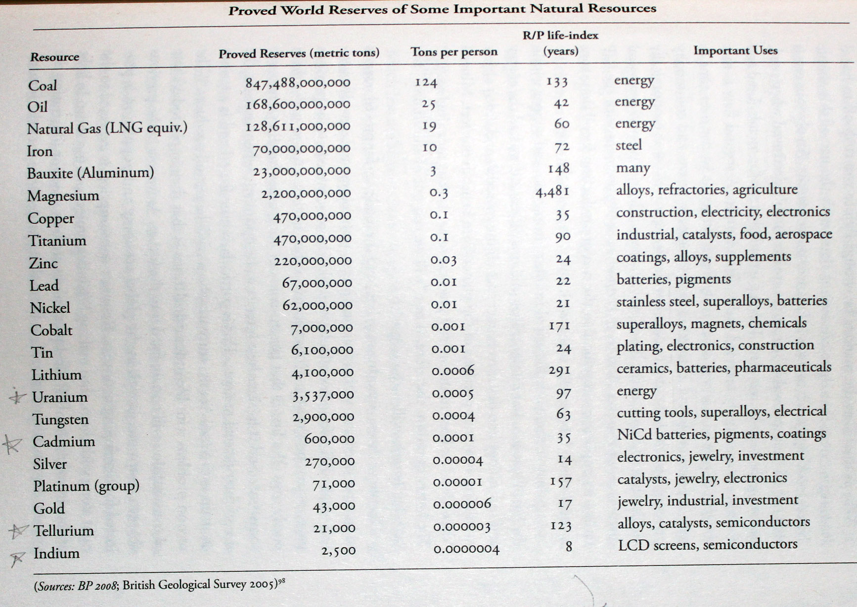
Future
Better models that take into account the growth of resource consumption with the growth of the economy “all indicate serious depletion of in-ground reserves of certain key metals, notably silver, gold, indium, tin, lead, zinc, and possibly copper, by the year 2050.
“Pressure is also rising on some other exotic metals (besides indium) needed by the electronic and energy industries, notably gallium and germanium for electronics; tellurium for solar power; thorium for next-generation nuclear reactors; molybdenum and cobalt for catylysts; and niobium, tantalum, and tungsten for making hardened synthetic materials.” (Smith, 2010, p.57)
In fact, the question isn’t “will we run out of REE?” but “to what lengths will we go to get them?”

Slide 14
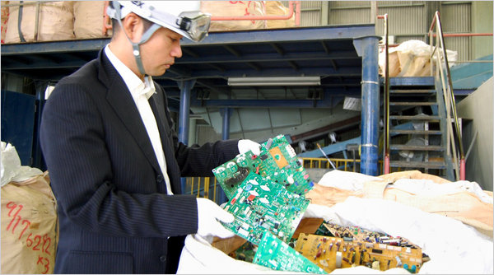
Call to Action
“In Kosaka, Dowa Holdings, the company that mined here for over a century, has built a recycling plant whose 200-foot-tall furnace renders old electronics parts into a molten stew from which valuable metals and other minerals can be extracted. […] Used electronics in Japan hold an estimated 300,000 tons of rare earths.” (Tabuchi, 2010)
In France, Rhodia is recycling magnets, low energy light bulbs, and NiMH rechargeable batteries (Rhodia.com, 2011).
http://news.cnet.com/8301-13579_3-57520121-37/digging-for-rare-earths-the-mines-where-iphones-are-born/

Slide 15
Bibliography
Alonso, Elisa, et. al.. (2012). Evaluating Rare Earth Element Availability: A Case with Revolutionary Demand from Clean Technologies, Environmental Science & Technology, 46(6). 3406-3414.
doi: 10.1021/es203518d
China to introduce tighter rules for rare earths mining. (2012). Mining Engineering Magazine, 64, 12. Retrieved from ProQuest Central database.
Guardian Weekly. (2012, August 7). Rare-earth mining in China Comes at a heavy cost for local villages. Retrieved on October 23, 2012 from
http://www.guardian.co.uk/environment/2012/aug/07/china-rare-earth-village-pollution
Huang, H. M., Xiao, X. M., &Yan, B. (2009). Recycle use of magnesium ammonium phosphate to remove ammonium nitrogen from rare-earth wastewater, Water and Science Technology, 59(6). 1093-1099.
doi: 10.2166/wst.2009.086
Humphries, Marc. (2012, June 8). Rare Earth Elements: The Global Supply Chain. Retrieved on September 16, 2012 from http://www.fas.org/sgp/crs/natsec/R41347.pdf
Kato, Yasuhiro, et. al.. (3 July 2011) Deep-Sea mud in the Pacific Ocean as a potential resource for rare-earth elements. Nature Geoscience. doi: 10.1038/NGEO1185 www.nature.com/naturegeoscience
Krebs, Robert E. (1998). The History and Use of Our Earth’s Chemical Elements: A Reference Guide. Westport, CT: Greenwood Press.
Long, K.R., Van Gosen, B.S., Foley, N.K., and Cordier, Daniel. (2010). The principal rare earth elements deposits of the United States—A summary of domestic deposits and a global perspective. [U.S. Geological Survey Scientific Investigations Report]. Retrieved September 24, 2012 from http://pubs.usgs.gov/sir/2010/5220/.

Slide 16
Bibliography (Cont’d)
Manahan, Stanley, E. (1997). Environmental Science and Technology. Boca Raton, FL: CRS Press LLC.
Ottens, Berthold. (2005). Mining in China: A 3000-Year Tradition. Mineralogical Record, 36(1), 4-11.
Perkowski, Jack. (2012, June 21). Behind China’s Rare Earth Controversy. [Blog Post, Forbes.com]. Retrieved from http://www.forbes.com/sites/jackperkowski/2012/06/21/behind-chinas-rare-earth-controversy/.
Perkowski, Jack. (2012, October 3). Get Ready for More China Overseas Investment. [Blog Post, Forbes.com]. Retrieved from
http://www.forbes.com/sites/jackperkowski/2012/10/03/get-ready-for-more-china-overseas-investment/.
Rhodia.com. (2011, October 3). Rhodia to recycle rare earths from magnets. [News Release]. Retrieved on October 23rd, 2012 from http://www.rhodia.com/en/news_center/news_releases/Recycle_rare_earths_031011.tcm
Smith, Laurence C. (2010). The World in 2050: Four Forces Shaping Civilizations Northern Future. New York, NY: Dutton.
Tabuchi, Hiroko. (2010, October 4). Japan Recycles Minerals From Used Electronics. Retrieved on October 22nd, 2012 from http://www.nytimes.com/2010/10/05/business/global/05recycle.html
WTO. Trade Policy Review. Report By China, May 8, 2012. WT/TPR/G/264 pg 12 http://docsonline.wto.org/GEN_highLightParent.asp?qu=rare+earth&doc=D%3A%2FDDFDOCUMENTS%2F T%2FWT%2FTPR%2FG264.DOC.HTM&curdoc=6&popTitle=WT%2FTPR%2FG%2F264

